Slide 1
Linear Algebra

Slide 2

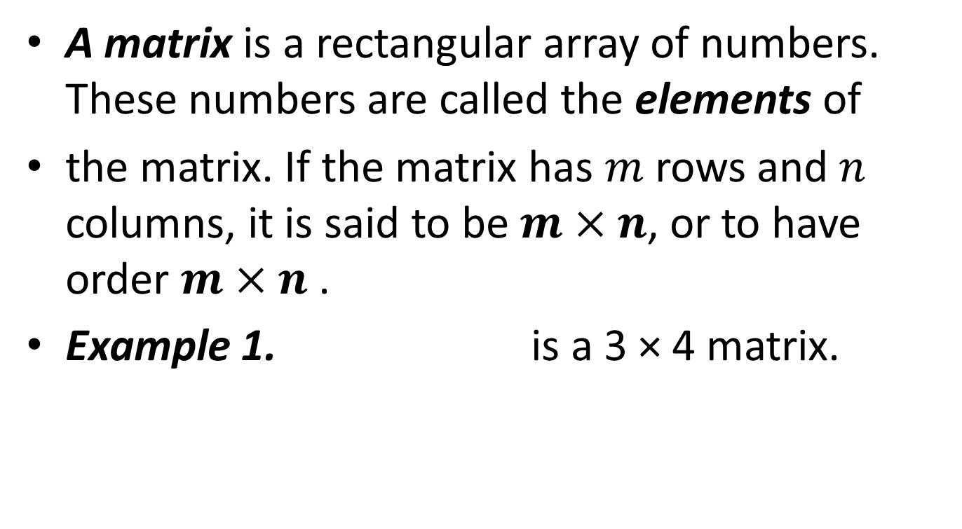
Matrices
A matrix is a rectangular array of numbers. These numbers are called the elements of
the matrix. If the matrix has $m$ rows and $n$ columns, it is said to be $m×n$, or to have order $m×n$.
Example 1. is a 3 × 4 matrix.

Slide 3

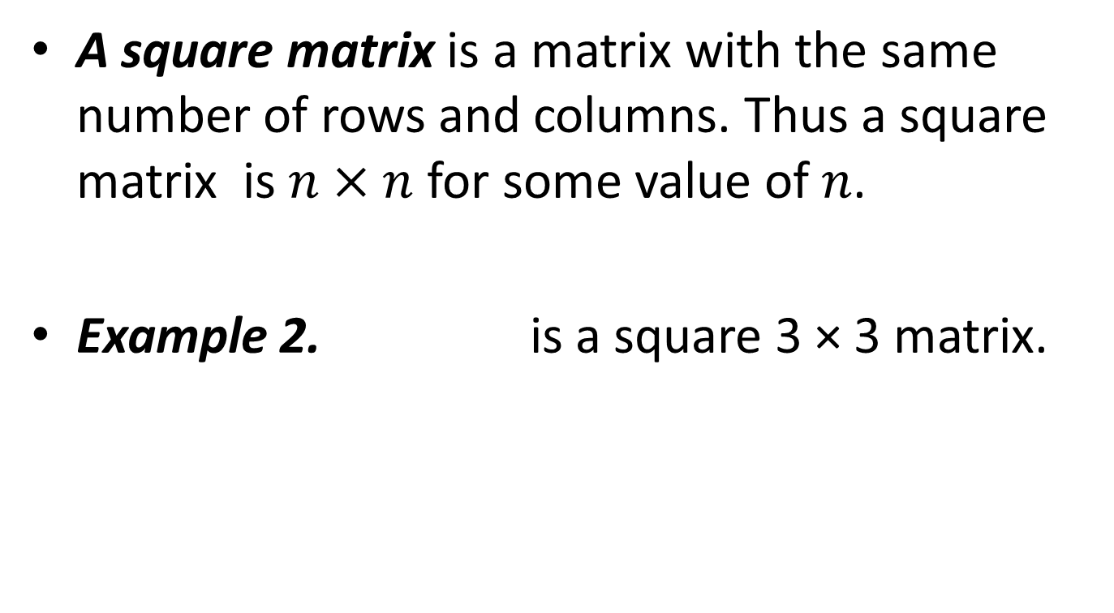
A square matrix is a matrix with the same number of rows and columns. Thus a square matrix is $n×n$ for some value of $n$.
Example 2. is a square 3 × 3 matrix.

Slide 4
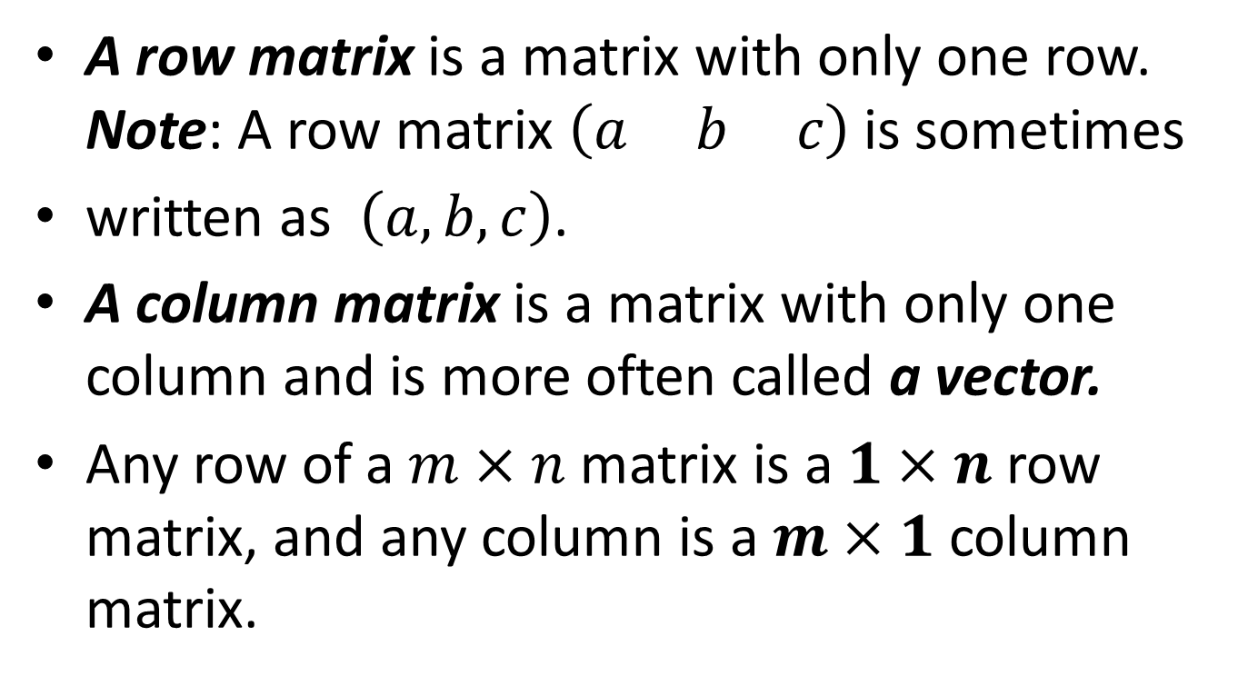
A row matrix is a matrix with only one row. Note: A row matrix $\left(a b c\right)$ is sometimes
written as $\left(a, b, c\right)$.
A column matrix is a matrix with only one column and is more often called a vector.
Any row of a $m×n$ matrix is a $1×n$ row matrix, and any column is a $m×1$ column matrix.

Slide 5
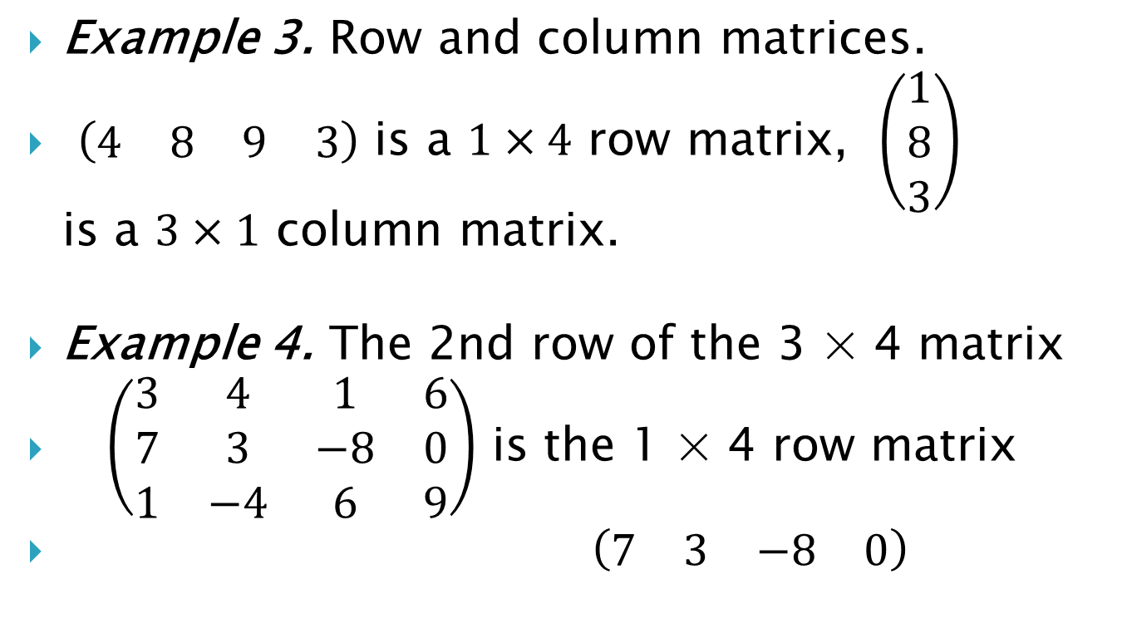
Example 3. Row and column matrices.
$\left(\begin{matrix}4 & 8 & 9 & 3\end{matrix}\right)$ is a $1×4$ row matrix, $\left(\begin{matrix}1 \\ 8 \\ 3\end{matrix}\right)$ is a $3×1$ column matrix.
Example 4. The 2nd row of the 3 × 4 matrix
$\left(\begin{matrix}3 & 4 & 1 & 6 \\ 7 & 3 & −8 & 0 \\ 1 & −4 & 6 & 9\end{matrix}\right)$ is the 1 × 4 row matrix
$\left(\begin{matrix}7 & 3 & −8 & 0\end{matrix}\right)$

Slide 6
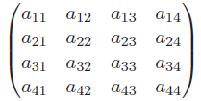
Matrix Notation
Each element of a matrix has its own particular location which can be defined by a system of double indices, the first indicating the row, the second the column.

Slide 7


Example 5.
Matrix can be denoted by a single general element in brackets, or by a single capital letter.

Slide 8


Equal matrices. Two matrices are equal if all the corresponding elements are equal. Thus, the two matrices must also be of the same order.
Example 6.

Slide 9

Zero matrices
A zero matrix (or null matrix) is a matrix with every element zero.
Example 7. is the 2 × 3 zero matrix.
The 1×1 zero matrix is just the number 0.

Slide 10


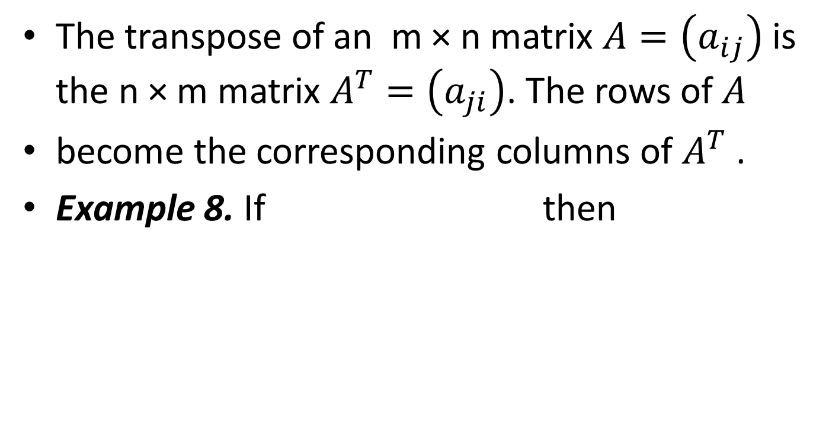
Transpose of a Matrix
The transpose of an m × n matrix $A=\left(a_{ij}\right)$ is the n × m matrix $A^{T}=\left(a_{ji}\right)$. The rows of $A$
become the corresponding columns of $A^{T}$ .
Example 8. If then

Slide 11
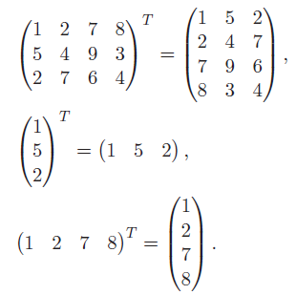
Example 9.

Slide 12

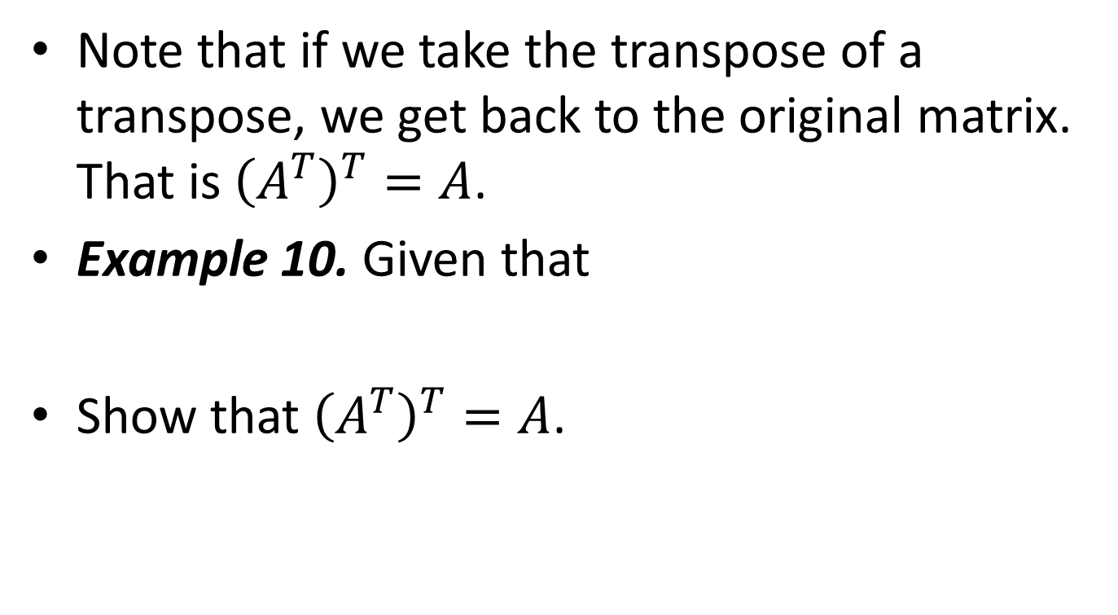
Note that if we take the transpose of a transpose, we get back to the original matrix. That is ${\left(A^{T}\right)}^{T}=A$.
Example 10. Given that
Show that ${\left(A^{T}\right)}^{T}=A$.

Slide 13
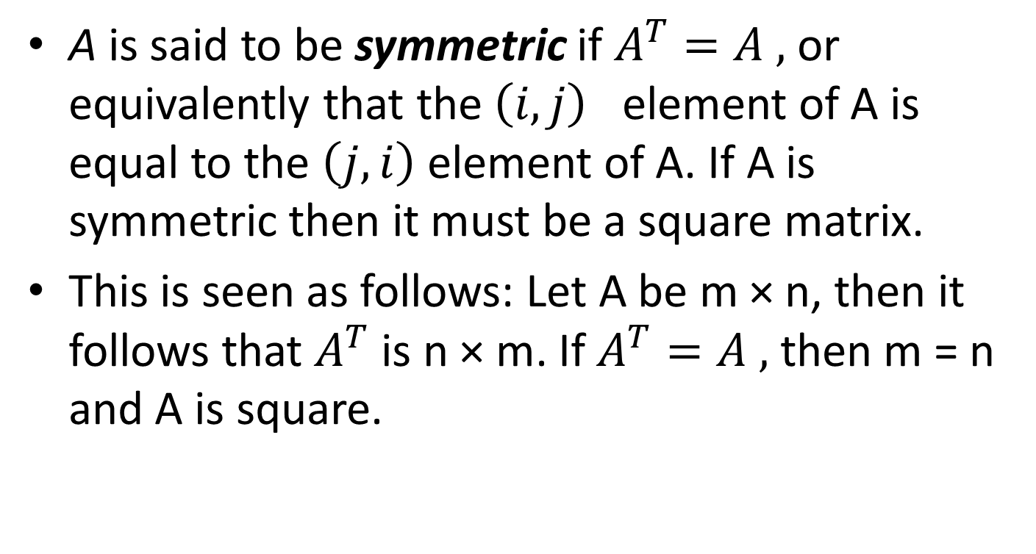
Symmetric Matrix
A is said to be symmetric if $A^{T}=A ,$ or equivalently that the $\left(i,j\right)$ element of A is equal to the $\left(j,i\right)$ element of A. If A is symmetric then it must be a square matrix.
This is seen as follows: Let A be m × n, then it follows that $A^{T}$ is n × m. If $A^{T}=A ,$ then m = n and A is square.

Slide 14

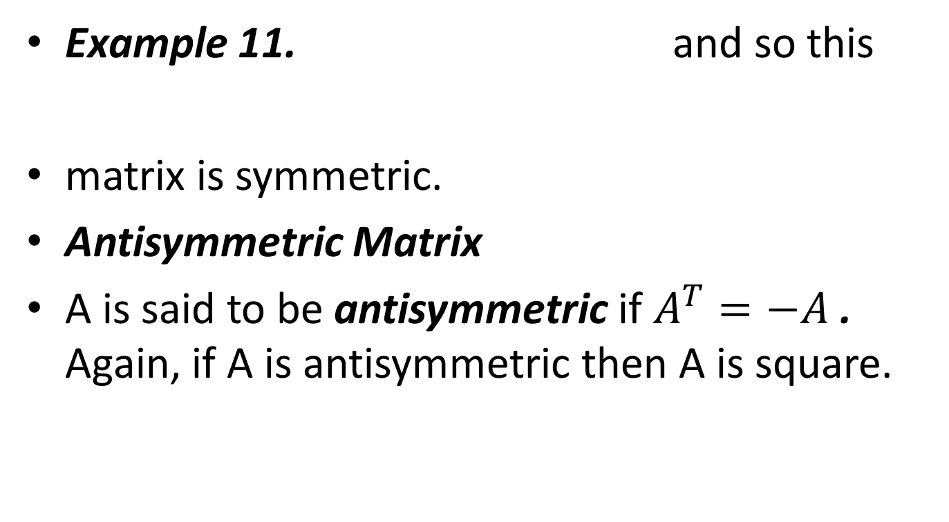
Example 11. and so this
matrix is symmetric.
Antisymmetric Matrix
A is said to be antisymmetric if $A^{T}=−A$. Again, if A is antisymmetric then A is square.

Slide 15
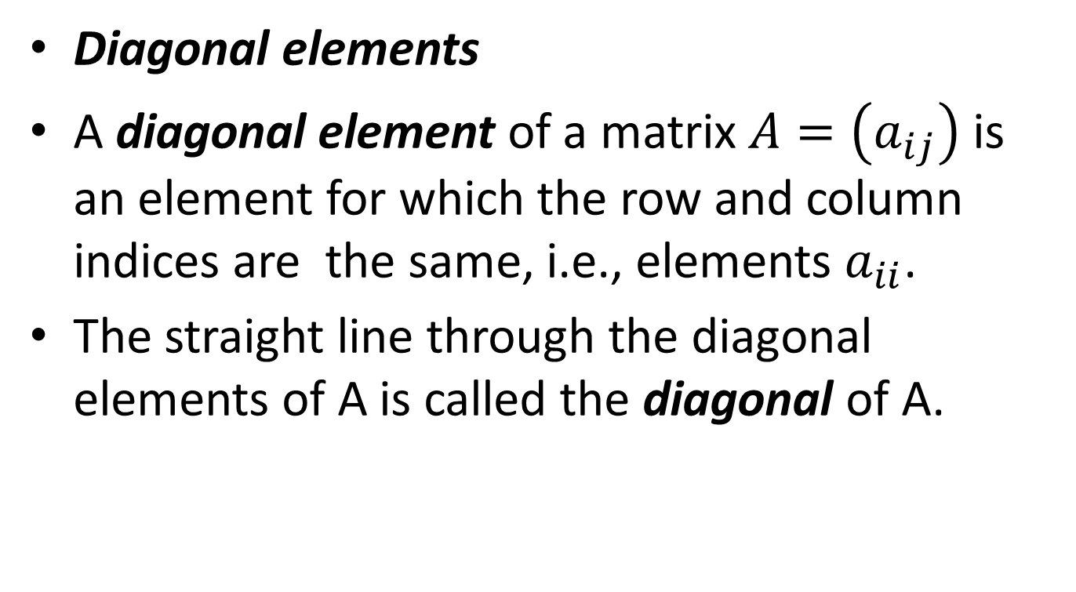
Diagonal elements
A diagonal element of a matrix $A=\left(a_{ij}\right)$ is an element for which the row and column indices are the same, i.e., elements $a_{ii}$.
The straight line through the diagonal elements of A is called the diagonal of A.

Slide 16
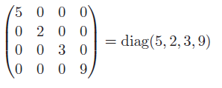
Diagonal Matrix
A diagonal matrix is a square matrix with all its non-diagonal elements zero. Diagonal element may or may not be zero.

Slide 17
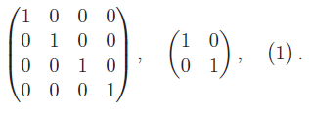
Identity Matrix
An identity matrix (or unit matrix) is a diagonal matrix with all its diagonal elements equal to one (and all the rest 0).
Example 12. Identity matrices of order 4,2 and 1.

Slide 18
Triangular matrices .
An upper-triangular matrix is a square matrix with only zero elements below its diagonal.
Elements on or above the diagonal may of may not be zero.
A lower-triangular matrix is a square matrix with only zero elements above its diagonal.
Elements on or below the diagonal may of may not be zero.

Slide 19
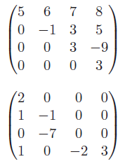
Example 13.
is upper-triangular.
is lower-triangular.

